Slide 1


Improved protein structure prediction using potentials from deep learning
學術討論會議
林思涵
2022/2/10

Slide 2

前情提要

Slide 3
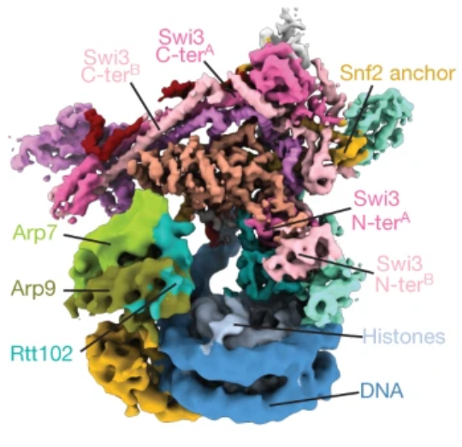
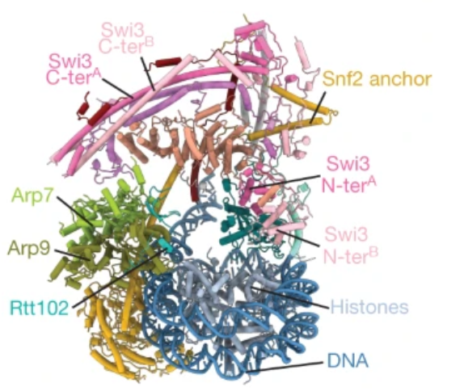
Cryo-EM structure and Protein structure

Slide 4
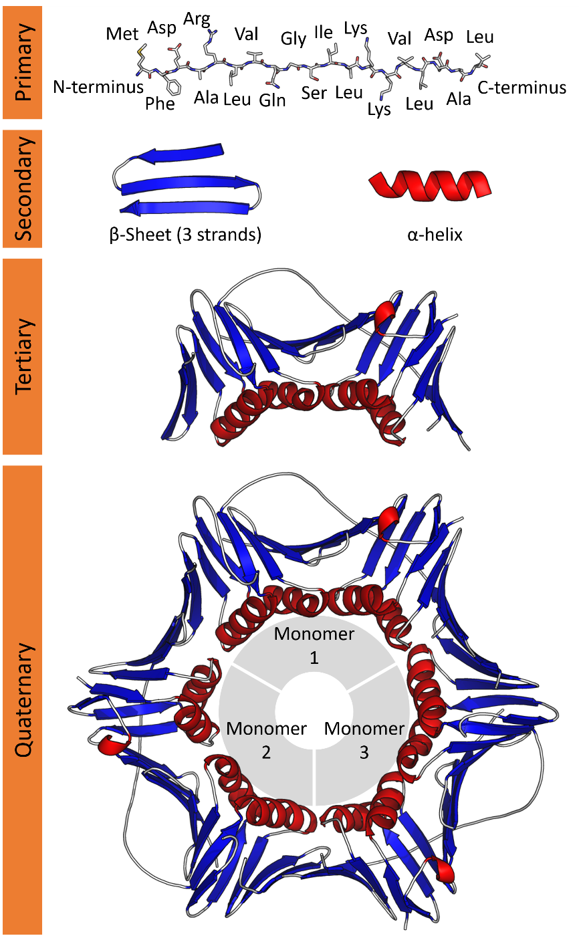
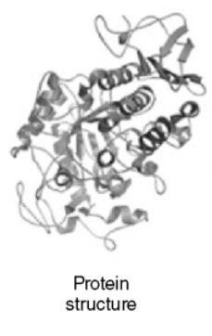
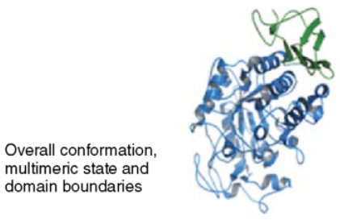
Protein structure and domain (Protein Sequence)

Slide 5
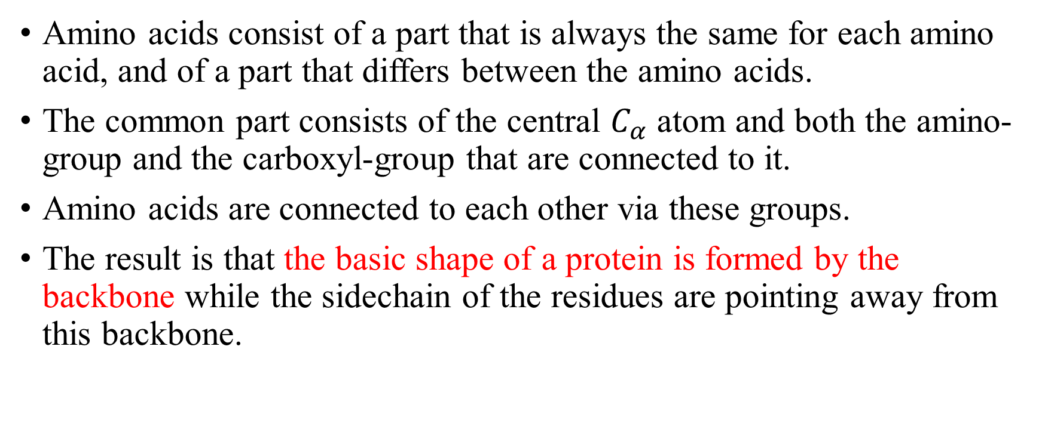
Backbone (Common part of amino acids)
Amino acids consist of a part that is always the same for each amino acid, and of a part that differs between the amino acids.
The common part consists of the central $C_{α}$ atom and both the amino-group and the carboxyl-group that are connected to it.
Amino acids are connected to each other via these groups.
The result is that the basic shape of a protein is formed by the backbone while the sidechain of the residues are pointing away from this backbone.

Slide 6
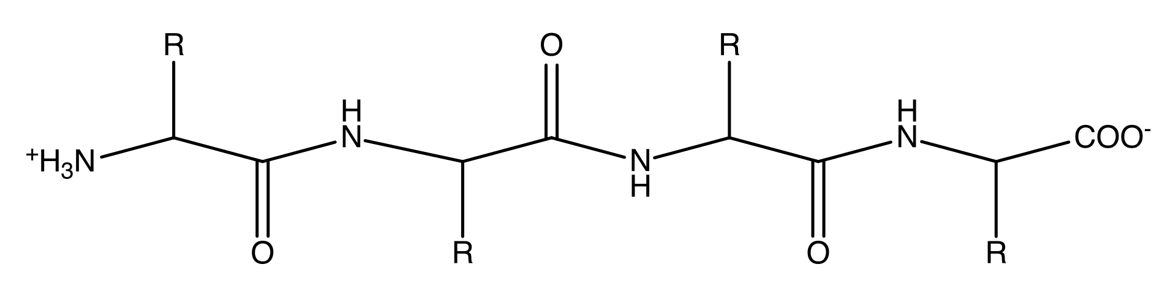
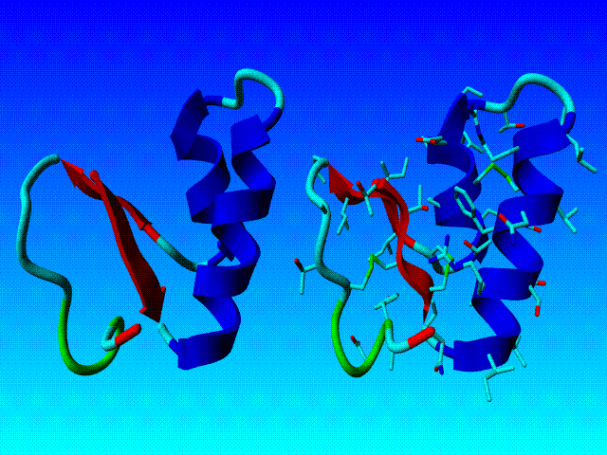
Backbone
Residue
Side chain

Slide 7
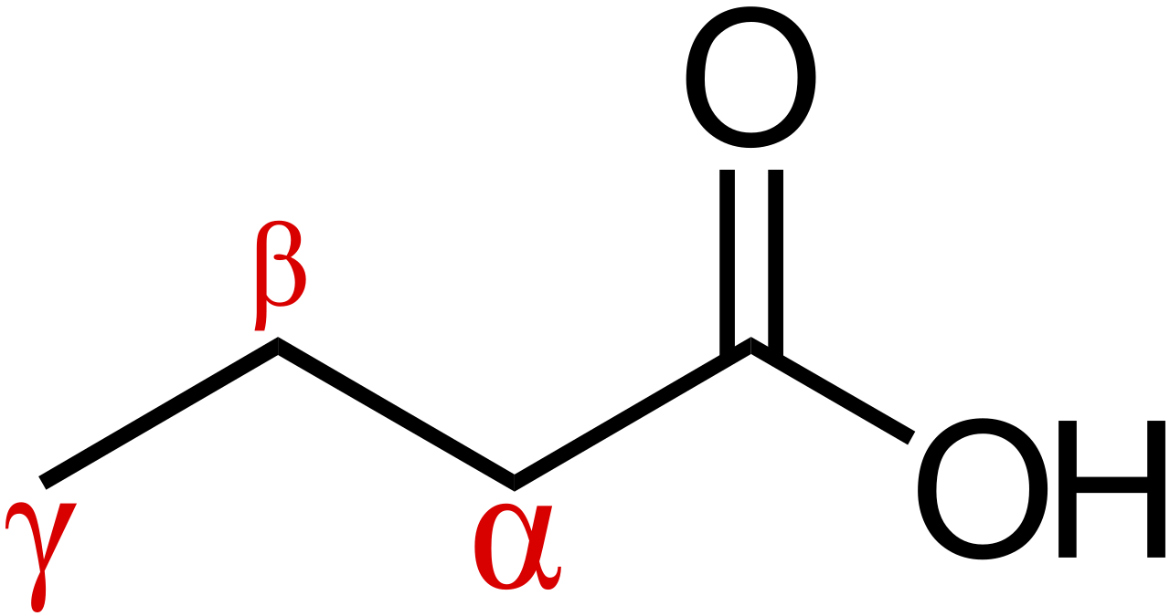
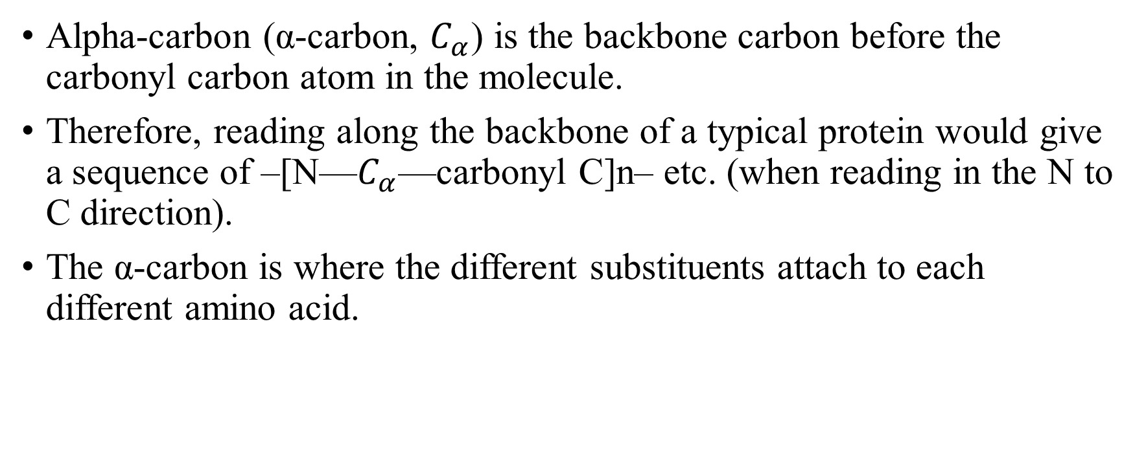
Proteins and amino acids (Alpha and beta carbon)
Alpha-carbon (α-carbon, $C_{α}$) is the backbone carbon before the carbonyl carbon atom in the molecule.
Therefore, reading along the backbone of a typical protein would give a sequence of –[N—$C_{α}$—carbonyl C]n– etc. (when reading in the N to C direction).
The α-carbon is where the different substituents attach to each different amino acid.

Slide 8
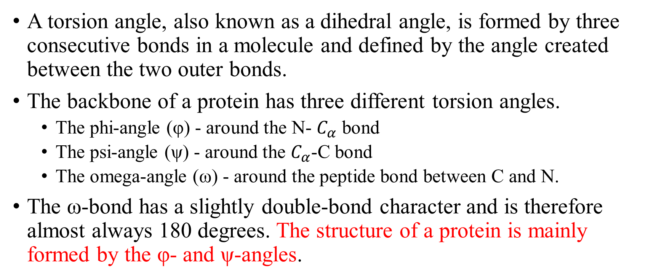
Torsion angle (The angle between two bonds)
A torsion angle, also known as a dihedral angle, is formed by three consecutive bonds in a molecule and defined by the angle created between the two outer bonds.
The backbone of a protein has three different torsion angles.
The phi-angle (φ) - around the N- $C_{α}$ bond
The psi-angle (ψ) - around the $C_{α}$-C bond
The omega-angle (ω) - around the peptide bond between C and N.
The ω-bond has a slightly double-bond character and is therefore almost always 180 degrees. The structure of a protein is mainly formed by the φ- and ψ-angles.

Slide 9
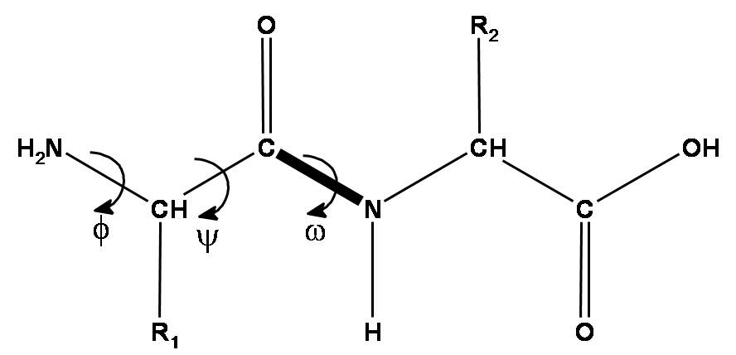
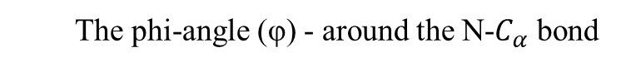
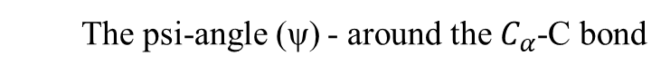
Torsion angle
The phi-angle (φ) - around the N-$C_{α}$ bond
The psi-angle (ψ) - around the $C_{α}$-C bond
The omega-angle (ω) - around the peptide bond between C and N

Slide 10
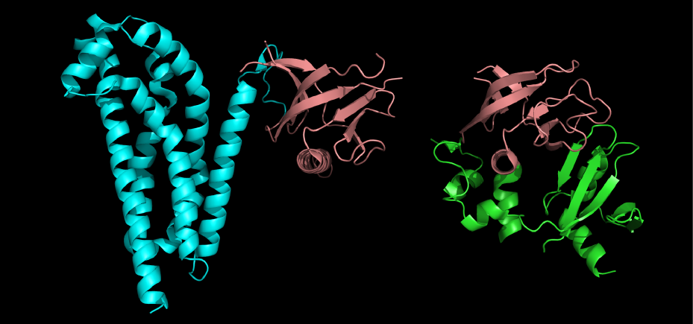
針對本篇需要懂的重點整理
2018的Critical Assessment of Protein Structure Prediction (CASP13)
共有98個團隊參加(AlphaFold為其中之一)
84個protein sequences
104個domains
(不同protein sequences上可能有相同的domain)
1個protein sequence上有L個Residues
domain
protein sequences
domains
residues

Slide 11
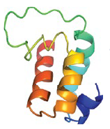
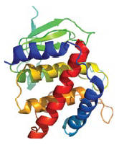
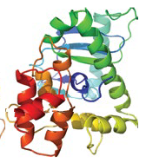
看懂protein sequences (S) and domains的編號
T0990-D1
T0990-D2
T0990-D3
類似於
這3個domains都在同一條protein sequenceT0990上
分成3段

Slide 12
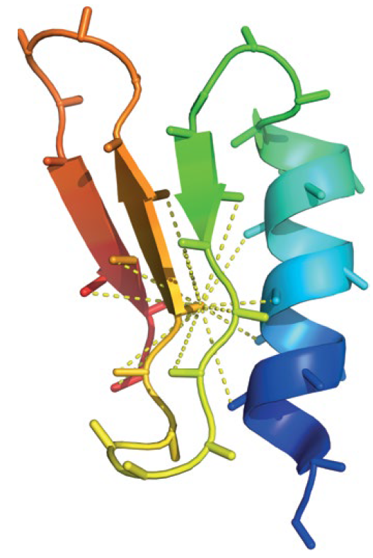
看懂domain上的residues與torsion angles
每一個Residue都有
的結構
29
Residue 41
所以每個Residue都有屬於它的torsion angle
Residue 2
Residue 1

Slide 13
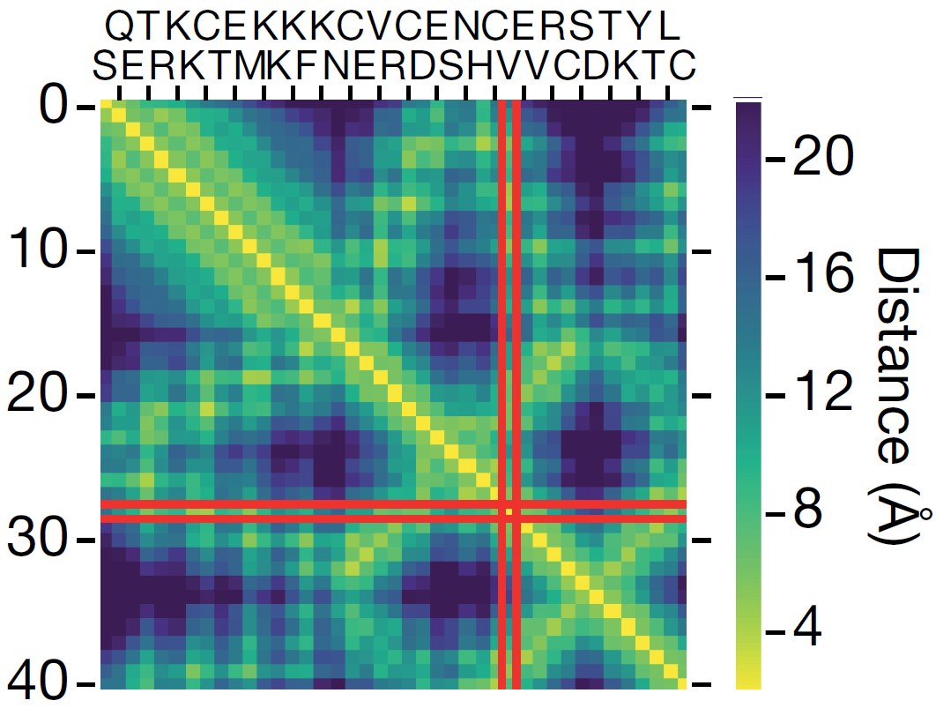
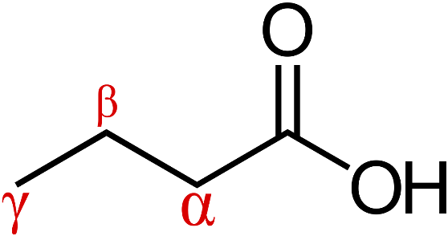
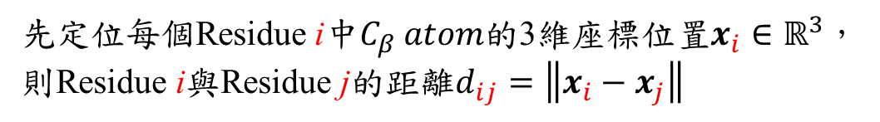
看懂domain上的residues與distances
每一個Residue都有
的結構
29
先定位每個Residue i中$C_{β}$𝑎𝑡𝑜𝑚的3維座標位置$x_{i}∈ℝ^{3}$，
則Residue i與Residue j的距離$d_{ij}=\left\|x_{i}−x_{j}\right\|$
Residue 41
Residue 2
Residue 1

Slide 14
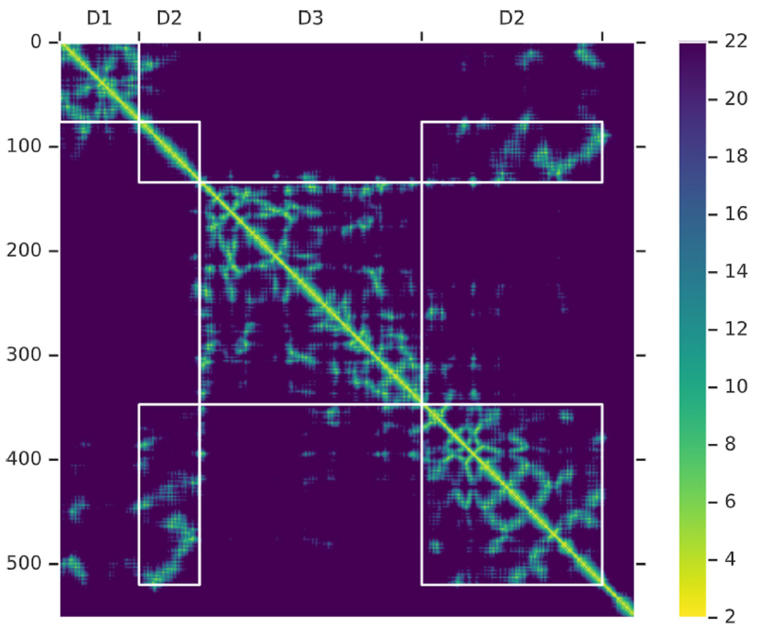
看懂protein sequences (S)上的residues與distances
T0990-D1
T0990-D2
T0990-D3

Slide 15
Improved protein structure prediction using potentials from deep learning (AlphaFold 1)

Slide 16
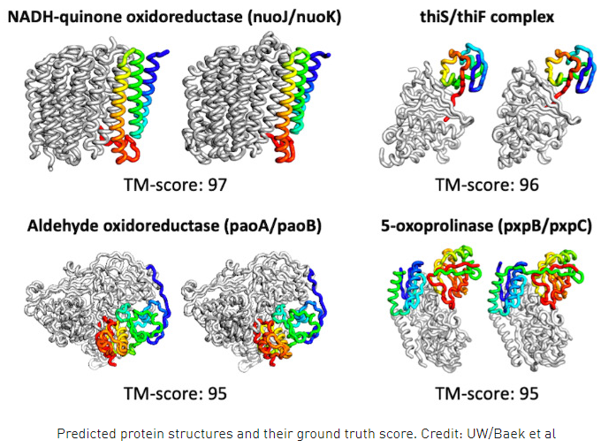
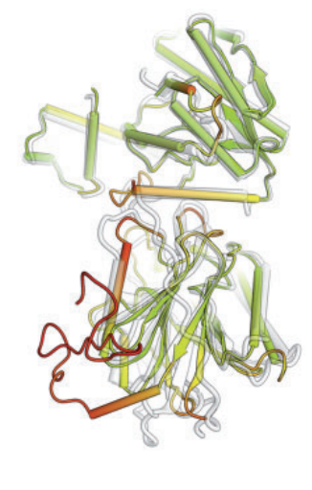
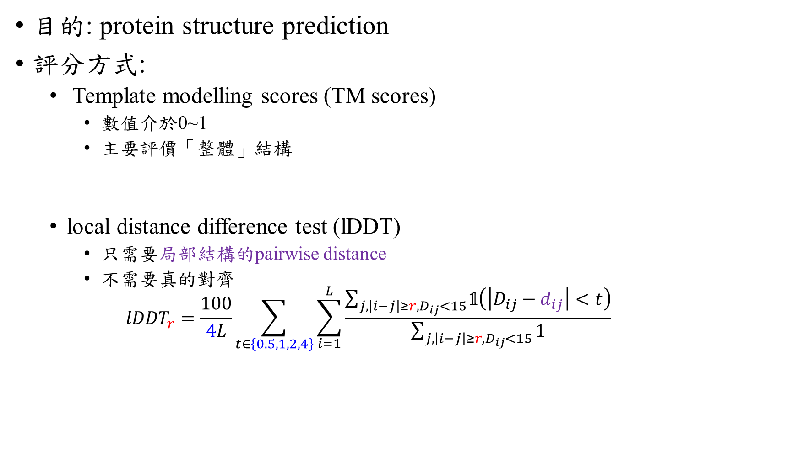
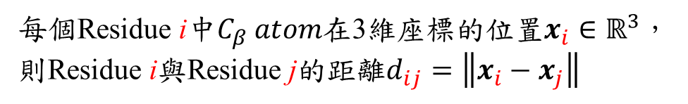
目的: protein structure prediction
評分方式:
Template modelling scores (TM scores)
數值介於0~1
主要評價「整體」結構
local distance difference test (lDDT)
只需要局部結構的pairwise distance
不需要真的對齊
$${lDDT}_{r}=\frac{100}{4L}\sum_{t∈\left\{0.5,1,2,4\right\}}{\sum_{i=1}^{L}{\frac{\sum_{j,\left|i−j\right|≥r,D_{ij}<15}{𝟙\left(\left|D_{ij}−d_{ij}\right|<t\right)}}{\sum_{j,\left|i−j\right|≥r,D_{ij}<15}{1}}}}$$
每個Residue i中$C_{β}$𝑎𝑡𝑜𝑚在3維座標的位置$x_{i}∈ℝ^{3}$，
則Residue i與Residue j的距離$d_{ij}=\left\|x_{i}−x_{j}\right\|$

Slide 17
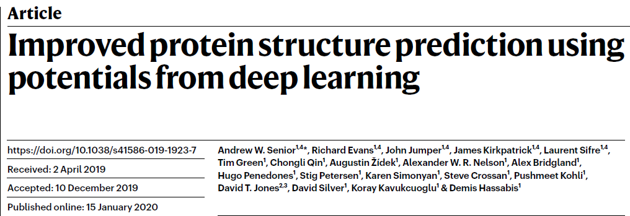
AlphaFold

Slide 18
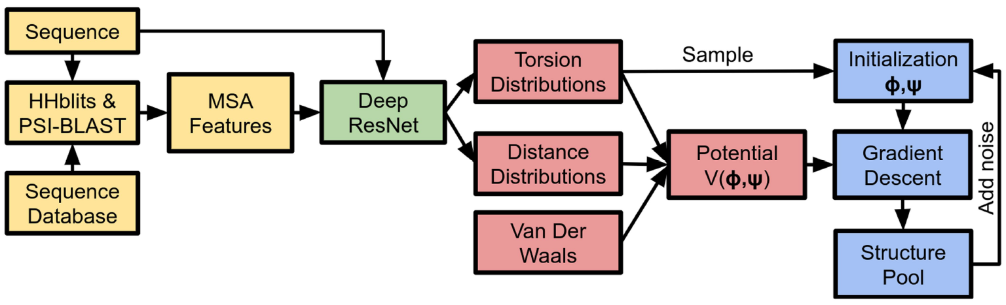
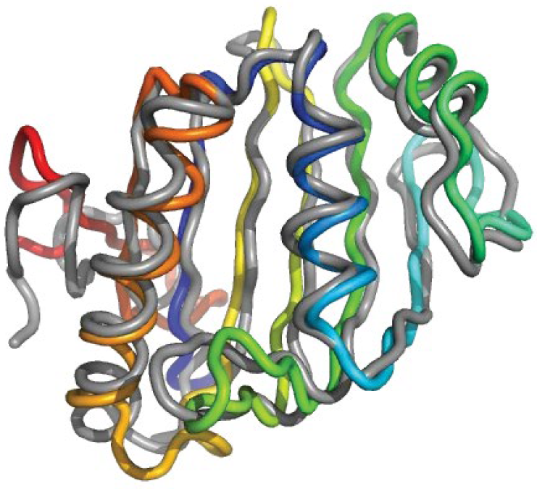
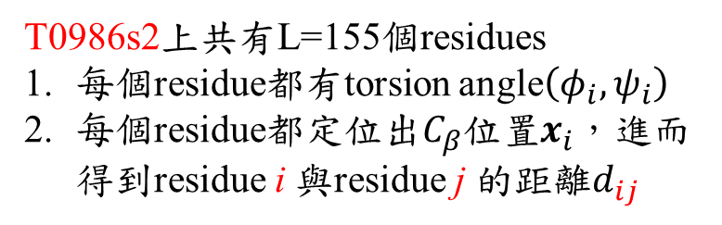
AlphaFold
Input
T0986s2
T0986s2上共有L=155個residues
每個residue都有torsion angle$\left(φ_{i},ψ_{i}\right)$
每個residue都定位出$C_{β}$位置$x_{i}$，進而得到residue i 與residue j 的距離$d_{ij}$
Output

Slide 19
AlphaFold
Input
T0986s2 (未知sequence, S)
Protein Data Bank (PDB)
多種已知結構
Output

Slide 20
未知sequence, S, 與PDB的關聯
Considerable progress has recently been made by leveraging genetic information.
It is possible to infer which amino acid residues are in contact by analyzing covariation in homologous sequences, which aids in the prediction of protein structures.

Slide 21
AlphaFold
Input
未知sequence, S
Protein Data Bank (PDB)
多種已知結構
存在與S類似的homologous sequences
Output

Slide 22
比對S與PDB中的Sequence的工具: HHblits
we searched for and aligned to the training sequence similar protein sequences in the Uniclust30 dataset with HHblits
Output: 多條與S相似的similar protein sequences
從similar protein sequences取得MSA features
Multiple sequence alignment (MSA)
And used the returned MSA to generate profile features with the position-specific substitution probabilities for each residue as well as covariation features

Slide 23
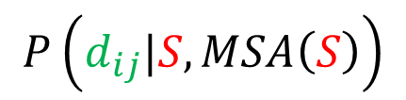
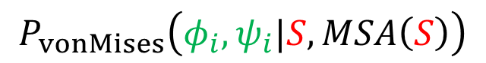
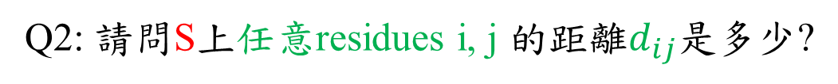
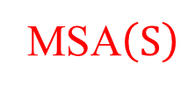
AlphaFold
Q1: 請問S上每個residue i的torsion angle$\left(φ_{i},ψ_{i}\right)$是多少?
Q2: 請問S上任意residues i, j 的距離$d_{ij}$是多少?
Input
未知sequence, S
$$P_{vonMises}\left(φ_{i},ψ_{i}|S,MSA\left(S\right)\right)$$
MSA$\left(S\right)$
Protein Data Bank (PDB)
多種已知結構
$$P\left(d_{ij}|S,MSA\left(S\right)\right)$$
存在與S類似的homologous sequences
Output

Slide 24
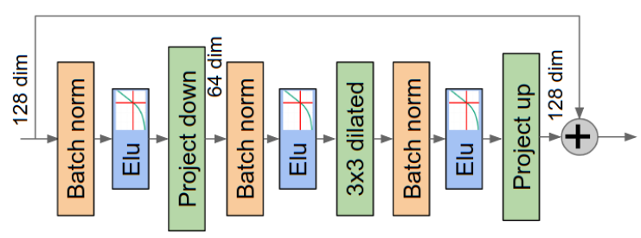
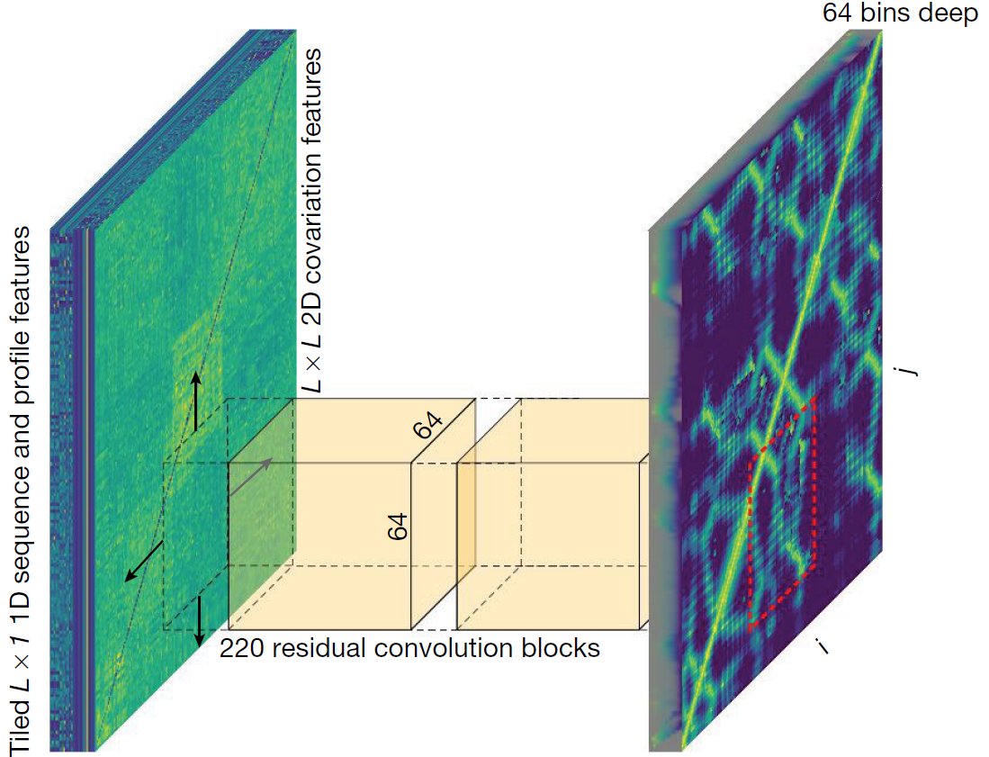
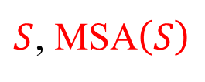
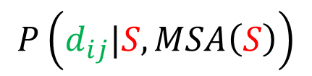
AlphaFold
$S$, MSA$\left(S\right)$
$$P\left(d_{ij}|S,MSA\left(S\right)\right)$$
Input
未知sequence, S
MSA$\left(S\right)$
Protein Data Bank (PDB)
多種已知結構
存在與S類似的homologous sequences
Output

Slide 25
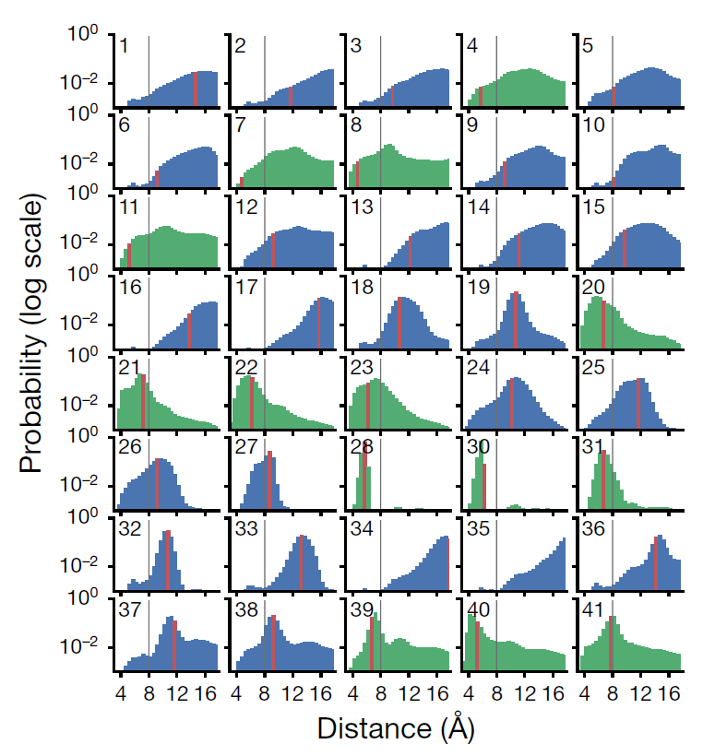
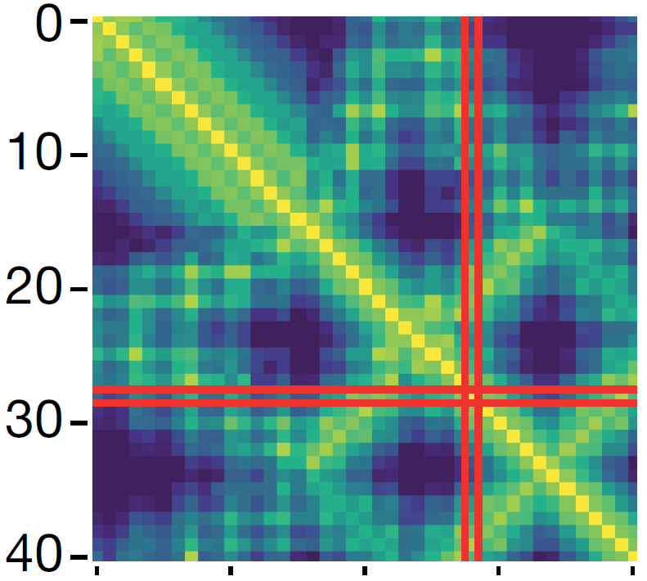
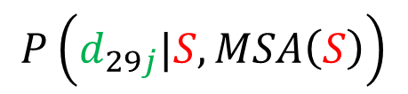
T0955，Residue 29
$$P\left(d_{29j}|S,MSA\left(S\right)\right)$$
共用41個residues
distogram
The mode of
the distance predictions
29
Contacts are typically defined to occur when the $β$-carbon atoms of 2 residues are within 8Å of one another

Slide 26
T0955，Residue 29
共用41個residues
Native inter-residue distances
The mode of
the distance predictions
29

Slide 27
AlphaFold
Input
未知sequence, S
$$P_{vonMises}\left(φ_{i},ψ_{i}|S,MSA\left(S\right)\right)$$
MSA$\left(S\right)$
Protein Data Bank (PDB)
多種已知結構
$$P\left(d_{ij}|S,MSA\left(S\right)\right)$$
存在與S類似的homologous sequences
Output

Slide 28
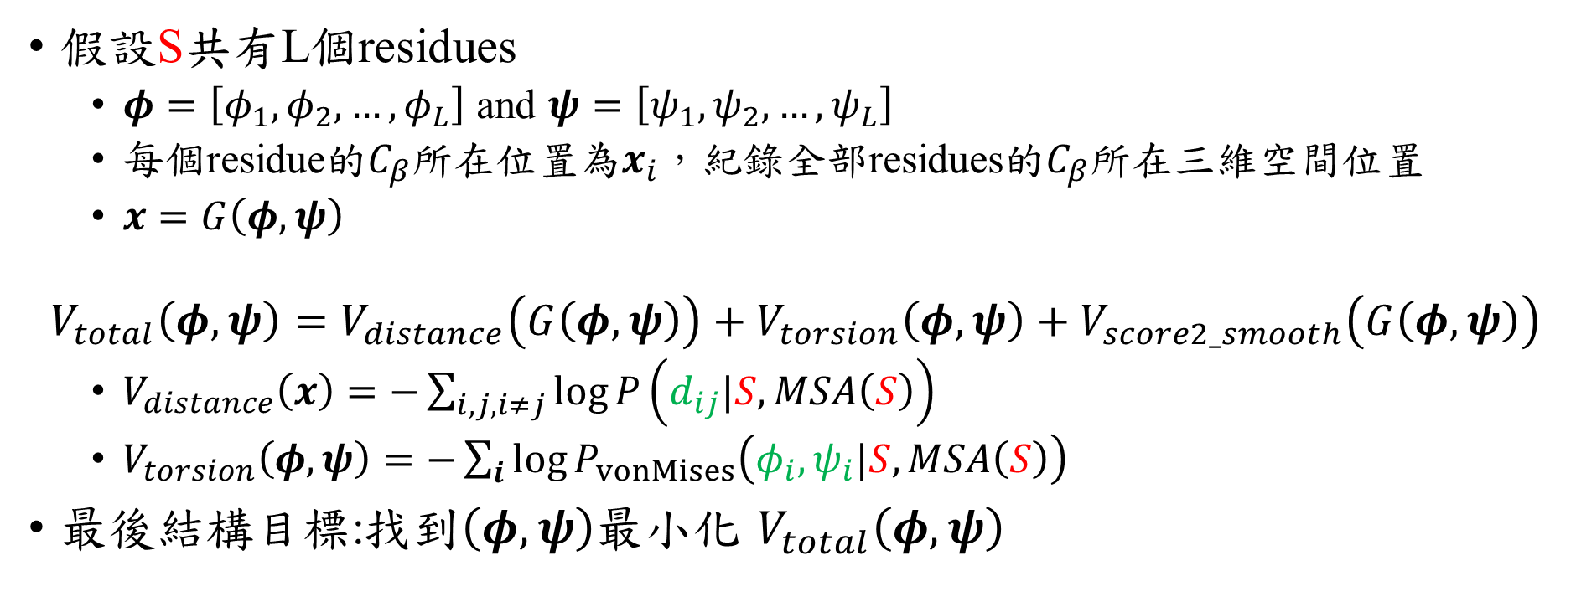
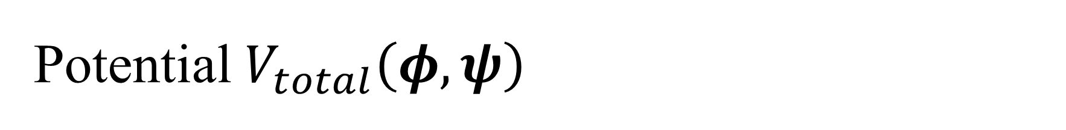
Potential $V_{total}\left(φ,ψ\right)$
假設S共有L個residues
$φ=\left[φ_{1},φ_{2},…,φ_{L}\right]$ and $ψ=\left[ψ_{1},ψ_{2},…,ψ_{L}\right]$
每個residue的$C_{β}$所在位置為$x_{i}$，紀錄全部residues的$C_{β}$所在三維空間位置
$x=G\left(φ,ψ\right)$
$$V_{total}\left(φ,ψ\right)=V_{distance}\left(G\left(φ,ψ\right)\right)+V_{torsion}\left(φ,ψ\right)+V_{score2_smooth}\left(G\left(φ,ψ\right)\right)$$
$V_{distance}\left(x\right)=−\sum_{i,j, i≠j}{\log{P\left(d_{ij}|S,MSA\left(S\right)\right)}}$
$V_{torsion}\left(φ,ψ\right)=−\sum_{i}{\log{P_{vonMises}\left(φ_{i},ψ_{i}|S,MSA\left(S\right)\right)}}$
最後結構目標:找到$\left(φ,ψ\right)$最小化 $V_{total}\left(φ,ψ\right)$

Slide 29
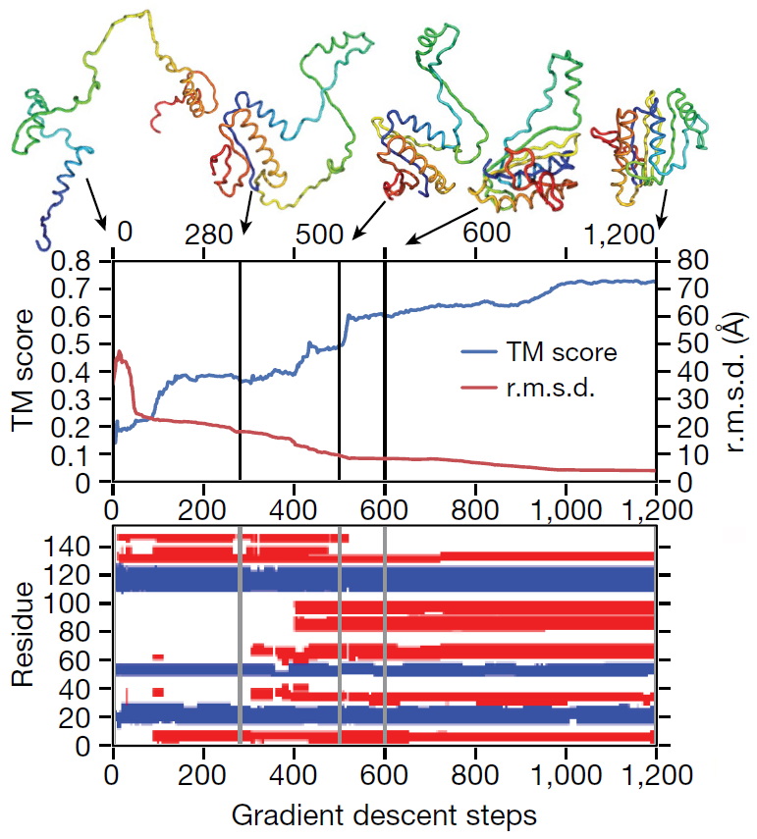
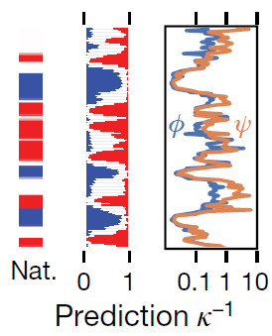
AlphaFold
T0986s2 (L=155)
Output

Slide 30
Simulations

Slide 31
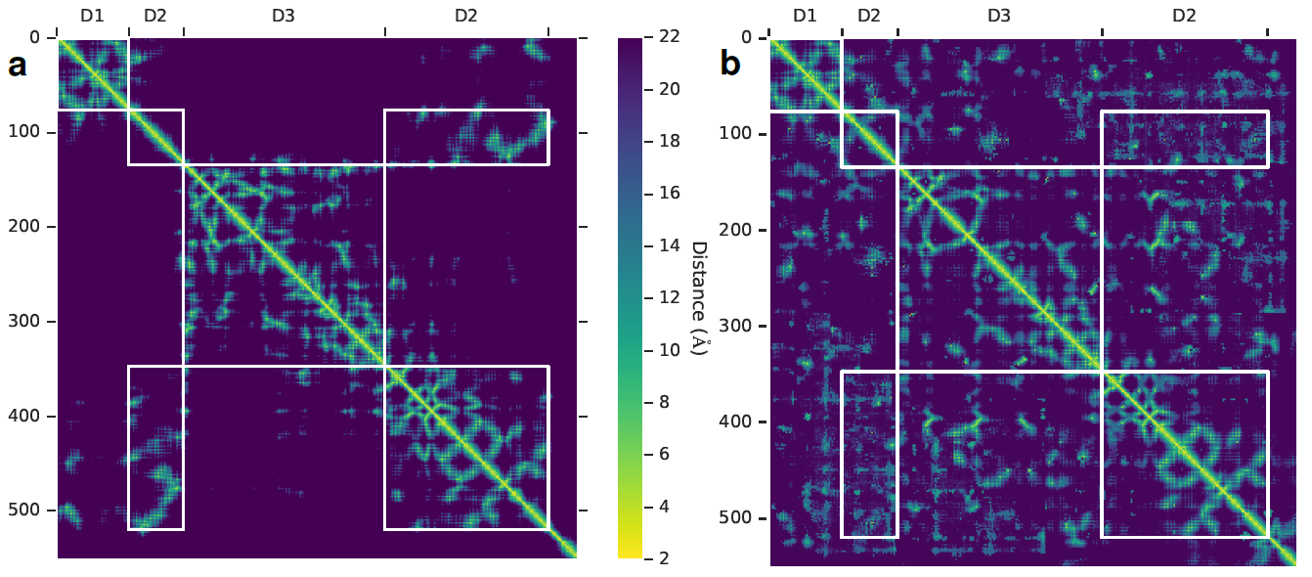
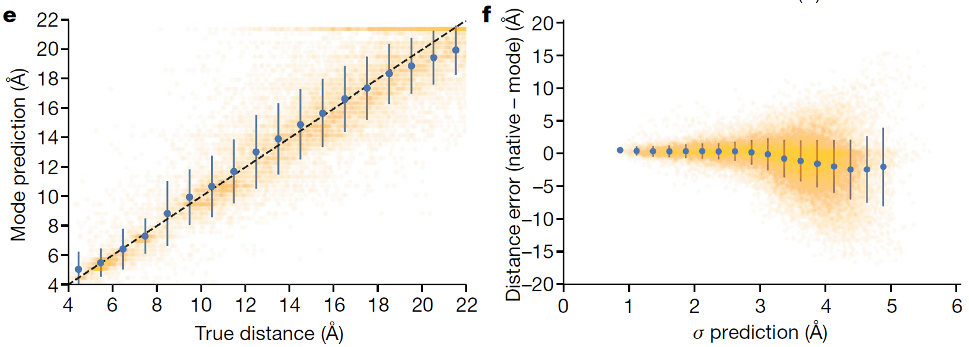
Distogram
T0990-D1
T0990-D2
T0990-D3

Slide 32
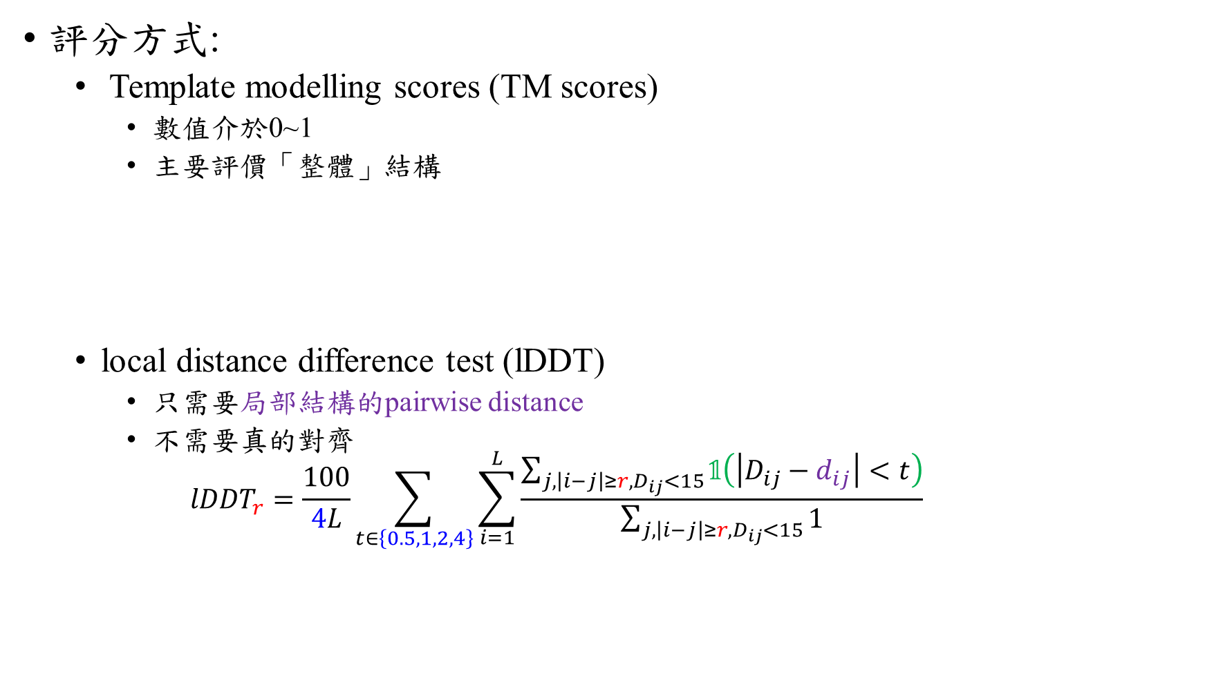
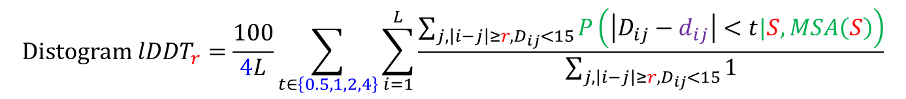
評分方式:
Template modelling scores (TM scores)
數值介於0~1
主要評價「整體」結構
local distance difference test (lDDT)
只需要局部結構的pairwise distance
不需要真的對齊
$${lDDT}_{r}=\frac{100}{4L}\sum_{t∈\left\{0.5,1,2,4\right\}}{\sum_{i=1}^{L}{\frac{\sum_{j,\left|i−j\right|≥r,D_{ij}<15}{𝟙\left(\left|D_{ij}−d_{ij}\right|<t\right)}}{\sum_{j,\left|i−j\right|≥r,D_{ij}<15}{1}}}}$$
每個Residue i中$C_{β}$𝑎𝑡𝑜𝑚在3維座標的位置$x_{i}∈ℝ^{3}$，
則Residue i與Residue j的距離$d_{ij}=\left\|x_{i}−x_{j}\right\|$
$$Distogram {lDDT}_{r}=\frac{100}{4L}\sum_{t∈\left\{0.5,1,2,4\right\}}{\sum_{i=1}^{L}{\frac{\sum_{j,\left|i−j\right|≥r,D_{ij}<15}{P\left(\left|D_{ij}−d_{ij}\right|<t|S,MSA\left(S\right)\right)}}{\sum_{j,\left|i−j\right|≥r,D_{ij}<15}{1}}}}$$

Slide 33

AlphaFold
$$V_{total}\left(φ,ψ\right)=V_{distance}\left(G\left(φ,ψ\right)\right)+V_{torsion}\left(φ,ψ\right)+V_{score2_smooth}\left(G\left(φ,ψ\right)\right)$$

Slide 34
CASP13中的AlphaFold

Slide 35


Slide 36
Supervised SUP
學術討論會議
林思涵
2022/2/10

Slide 37




Self-updating process (SUP) Clustering algorithm
$$X_{k}^{t+1}=\sum_{i=1}^{n}{w_{ki}^{t}X_{i}^{t}}，w_{ki}^{t}=\frac{1}{W}exp\left(−\frac{{\left\|X_{i}^{t}−X_{k}^{t}\right\|}^{2}}{2σ^{2}}\right)$$
一維範例:

Slide 38



二維範例:
(不使用label資訊)

Slide 39

Supervised SUP Classification algorithm (Training data)
輸入: 資料+label 資訊
期望目標

Slide 40




如何加入label資訊?
$$X_{k}^{t+1}=\sum_{i=1}^{n}{w_{ki}^{t}X_{i}^{t}}，w_{ki}^{t}=\frac{1}{W}exp\left(−\frac{{\left\|X_{i}^{t}−X_{k}^{t}\right\|}^{2}}{2σ^{2}}\right)$$
100倍的
max 原始D
1.計算資料的pairwise distance $\left\|X_{i}^{t}−X_{k}^{t}\right\|$，並根據不同組別進行修改
原始D
修改後的D

Slide 41



成果:
幾乎一步到位，沒什麼中間變化過程

Slide 42


引入 $0<α<1$，並記錄中間過程
$$X_{k}^{t+1}=α∙\sum_{i=1}^{n}{w_{ki}^{t}\left(X_{i}^{t}−X_{k}^{t}\right)}+X_{k}^{t}，$$
其中
$$w_{ki}^{t}=\frac{1}{W}exp\left(−γ∙\frac{{\left\|X_{i}^{t}−X_{k}^{t}\right\|}^{2}}{2σ^{2}}\right)$$
$$σ=\text{max} \text{原始}\text{D}$$

Slide 43







成果: $α=0.2$，共30 iterations
具有中間的變化過程
並記錄下pattern

Slide 44
Training data
$$X_{k}^{t+1}=α∙\sum_{i=1}^{n}{w_{ki}^{t}\left(X_{i}^{t}−X_{k}^{t}\right)}+X_{k}^{t}，$$
其中
$$w_{ki}^{t}=\frac{1}{W}exp\left(−γ∙\frac{{\left\|X_{i}^{t}−X_{k}^{t}\right\|}^{2}}{2σ^{2}}\right)$$
$$σ=\text{max} \text{原始}\text{D}$$

Slide 45





Test data
$$Y^{t−1}$$
$${\tilde{X}}_{i}^{t−1}$$
想法: 藉由附近k個training data或是路徑上的資訊
$$Y^{t}=Y^{t−1}+\sum_{i=1}^{k}{w_{i}V_{i}}$$
其中
$$V_{i}=\frac{1}{2}\left[\left({\tilde{X}}_{i}^{t}−{\tilde{X}}_{i}^{t−1}\right)+\left({\tilde{X}}_{i}^{t}−Y^{t−1}\right)\right]$$
$$w_{i}=\frac{1}{W}∙exp\left(−{\left\|Y^{t−1}−{\tilde{X}}_{i}^{t−1}\right\|}^{2}\right)$$
$$V_{i}$$
$${\tilde{X}}_{i}^{t}$$

Slide 46






4 ($α$ = 1)
Iteration = 28 ($α$ = 0.2)
$$X_{k}^{t+1}=α∙\sum_{i=1}^{n}{w_{ki}^{t}\left(X_{i}^{t}−X_{k}^{t}\right)}+X_{k}^{t}$$
$$Y^{t}=Y^{t−1}+\sum_{i=1}^{k}{w_{i}\left(\frac{1}{2}\left[\left({\tilde{X}}_{i}^{t}−{\tilde{X}}_{i}^{t−1}\right)+\left({\tilde{X}}_{i}^{t}−Y^{t−1}\right)\right]\right)}$$
Training
Testing

Slide 47


用於MNIST
Training Data
Testing Data
正確率:90%

Slide 48
The End

